Slide 1

CAPTURE OF DARK ATOMS BY CELESTIAL BODIES
Student:
А.М. Khalilova
Research Advisor:
M.Yu. Khlopov, Dr. Sci. (Phys.-Math.), Prof., Dept. No. 40
Bled, 2026

Slide 2


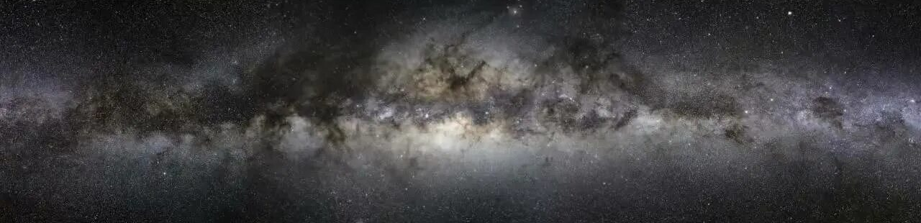
RELEVANCE AND OBJECTIVES
Long-term searches for weakly interacting massive particles (WIMPs) have not yielded any results, which motivates the development of alternative scenarios. One such scenario is the dark atom model: bound states of a multiply charged particle with helium nuclei:
2

Slide 3

AIM AND OBJECTIVES
Aim: theoretical modeling of dark atom capture, estimation of the heat flux from their thermalization and fusion reactions, as well as determination of the dark atom distribution inside celestial bodies.
Objectives:
Describe the dark atom model and the constraints on its parameters from experimental data;
Estimate the thermalization depth of dark atoms inside a celestial body;
Obtain analytical expressions for the energy release due to fusion reactions of dark atoms with ordinary matter nuclei;
Construct a heat conduction equation with two heating sources — thermalization and fusion reactions;
Obtain the concentration distribution of dark atoms inside an object taking into account diffusion, gravity, and the sink due to reactions;
Solve the resulting equations for asteroid Ida.

Slide 4


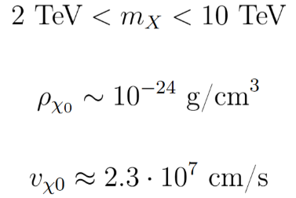
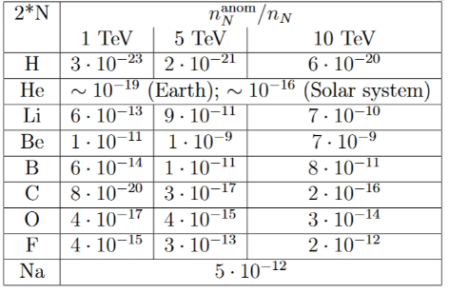
MODEL AND CONSTRAINTS
Dark atoms are hypothetical composite dark matter particles — bound states of a multiply charged particle with helium nuclei: Unlike traditional WIMPs, dark atoms have nuclear interactions with ordinary matter.
Allowed concentrations of anomalous isotopes:
Parameters:
Mass:
Density in the galactic halo:
Velocity relative to celestial bodies:

Slide 5

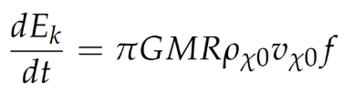

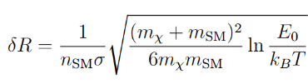


CAPTURE AND THERMALIZATION
Dark atom flux:
Total energy release power:
Average energy loss per collision:
Thermalization depth:
G – gravitational constant, M and R – mass and radius of the celestial body, f – fraction of captured particles, E – particle energy before collision, – particle energy when incident on the celestial body, – number density of ordinary matter nuclei, – scattering cross-section of the dark atom with a nucleus, – mass of the ordinary nucleus with which the interaction occurs, – Boltzmann constant.
For parameters typical of the Earth’s crust (ordinary matter number density - , temperature 270 К) and for dark atom’s mass 2 TeV: 60 m.

Slide 6



REACTIONS WITH ORDINARY NUCLEI
Energy release power:
( - energy release of a single reaction, can be found as the mass difference between the reaction products and the initial nuclei (is estimated in the tens of MeV range), - concentration of dark atoms in a given volume, - product of the interaction cross-section and the relative velocity of the dark atom and the nucleus).
Characteristic reaction time for s : s (about a year).
HEAT CONDUCTION EQUATION
Boundary conditions:

Slide 7


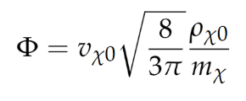
DARK ATOM DISTRIBUTION
Continuity equation:
( - diffusion velocity)
Diffusion equation:
Boundary condition:
(here )

Slide 8


APPLICATION TO SPECIFIC CELESTIAL BODIES
Asteroid Ida
Planet 9
– a hypothetical body beyond the Kuiper belt, whose existence is proposed to explain the anomalous clustering of the orbits of certain trans-Neptunian objects.
Mission Galileo data:
Diameter: 31 km;
Density: 2.7 g/cm³;
Surface temperature: 155 K;
Central temperature: 280 K;
Composition: oxygen (40%), iron (22%), silicon (18%), magnesium (15%).
Assumed parameters:
Mass:
Radius:
Distance from the Sun: 400–800 AU
Temperature from solar heating: 10-15 К
Dark atoms accumulate in a narrow near-surface layer, and their concentration drops sharply with depth. At the surface, we obtain a temperature change due solely to dark atoms – 0,6 K. Further inside the thermalization layer, the temperature decreases quadratically to 0,1 K and maintains this value throughout the entire volume.

Slide 9

CONCLUSION
The thermalization depth of dark atoms is estimated to be 60 m;
A heat conduction equation is constructed taking into account both the thermalization of dark atoms and the energy released in fusion reactions with ordinary nuclei;
A diffusion equation for dark atoms is derived incorporating gravity, temperature gradient, and the sink due to reactions;
In the asteroid Ida dark atoms accumulate in a narrow near-surface layer and the temperature change is very small;
The fraction of dark atoms in the near-surface accumulation layer inside the asteroid is estimated as ;
Prospects for using the model to search for hypothetical Planet 9 in the infrared range are discussed;
This model can be applied to determine the dark atom distribution and thermal balance in other celestial bodies.

